Slide 1
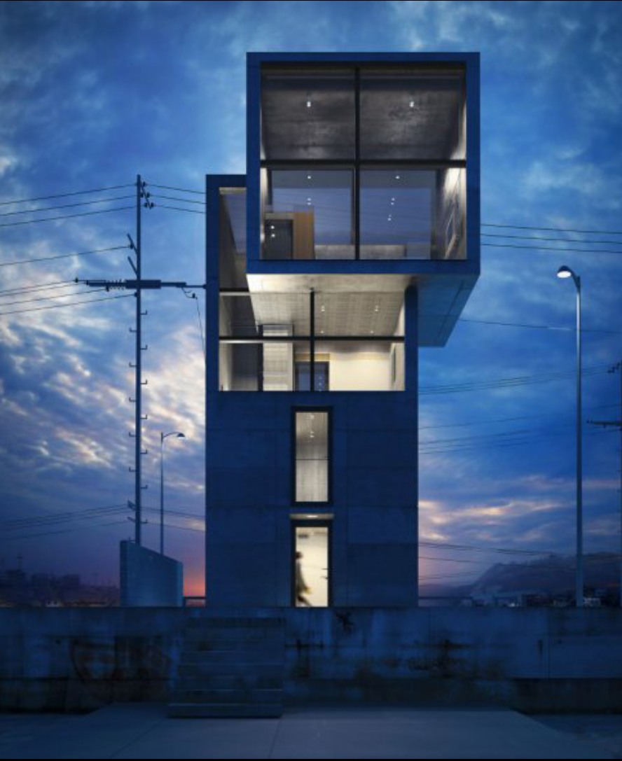
TADAO ANDO
ANJALI RAJEEV
2013701037
HARSHINIE SHRI
2013701012

Slide 2
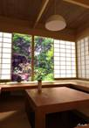
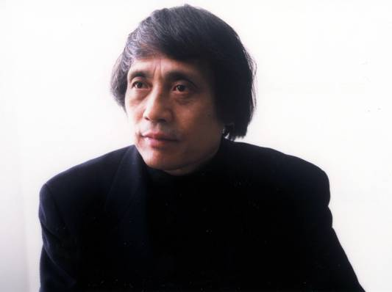
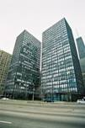
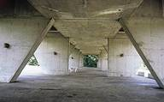
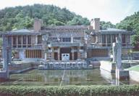
Tadao Ando
Notes:
Born in 1941 in Osaka, Japan
Carpenter
Self-taught Architect
Apprenticed, but mostly traveled and drew
Influenced by Le Corbusier, Mies van der Rohe, Alvar Aalto, Frank Lloyd Wright and Louis Kahn

Slide 3
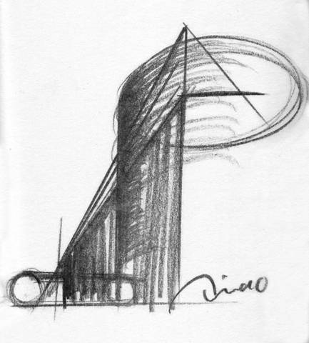
Influences:
Japanese Tea House; Mies van der Rohe, Lake Shore Drive Apartments; Frank Lloyd Wright, Imperial Hotel; Le Corbusier, Unite d’Habitation

Slide 4
Born | September 13, 1941 (age 72) Minato-ku, Osaka, Japan
Nationality | Japanese
Awards | Alvar Aalto Medal, 1985 Pritzker Prize, 1995 RIBA Royal Gold Medal, 1997 AIA Gold Medal, 2002 Neutra Medal for Professional Excellence, 2012
Practice | Tadao Ando Architects & Associates
Buildings | Row House, Sumiyoshi, 1979 Church of the Light, Osaka, 1989 Water Temple, Awaji, 1991
Projects | Rokko Housing I, II, III, Kobe, 1983-1999

Slide 5
STYLE
Uses personal experiences
unmoved by architecture that springs entirely by intellect
hates the manipulation of knowledge and games with form.
Architect of Light
Master of Space
Builder for Humanity

Slide 6
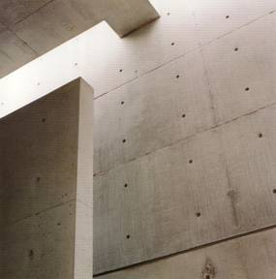
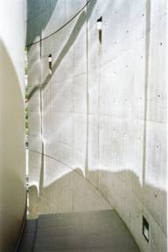
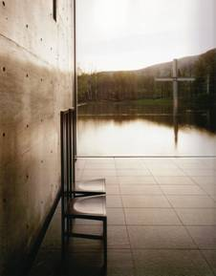
Light
Space
Humanity
Koshino House Ashiya (1979-81)
Collezzione Tokyo (1989)
Church on the Water Ashiya (1979-81)

Slide 7
SPACE AND SHINTAI
seeks neither beautiful nor skilful architecture.
values only intrepid architecture defined by victory over dilemma, suffering and fear
because unlike surface beauty the only expression that invokes sublime emotions in the beholder is that on which a creator stakes his or her life.

Slide 8
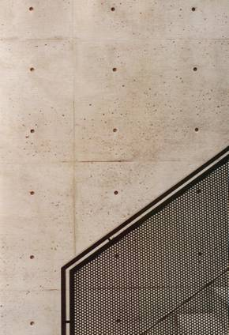
Works primarily in concrete
Concrete
Oxy Unagidani Osaka (1986-1987)

Slide 9
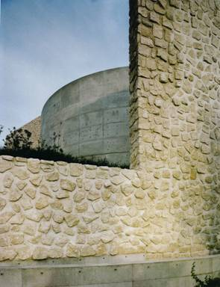
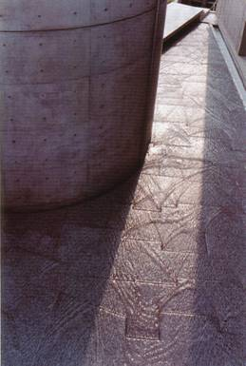
Naoshima Contemporary Art Museum Kagawa (1988-92)
Unifies Building and Nature to create deep sense of Sanctuary
Sanctuary
Nature
Meditation Space UNESCO (1995)

Slide 10
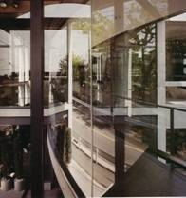
Walls
walls regulate movement
and bring order.
Walls command us, divide us,
unite us and bear responsibility and
power over human relations.
stimulate the self-awareness of those who behold them, absorbing their gaze.
Old/New Rokko Restaurant Kobe (1985-86)

Slide 11
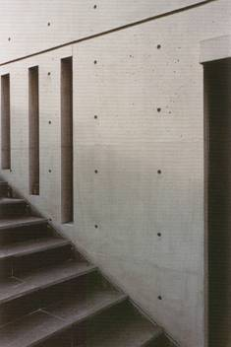
Their polished concrete surfaces accept our empathy, and function almost as a mirror for our hearts.
reflect the patterns of our hearts, gradually absorbing our consciousness.
Koshino House Ashiya (1979-81)

Slide 12
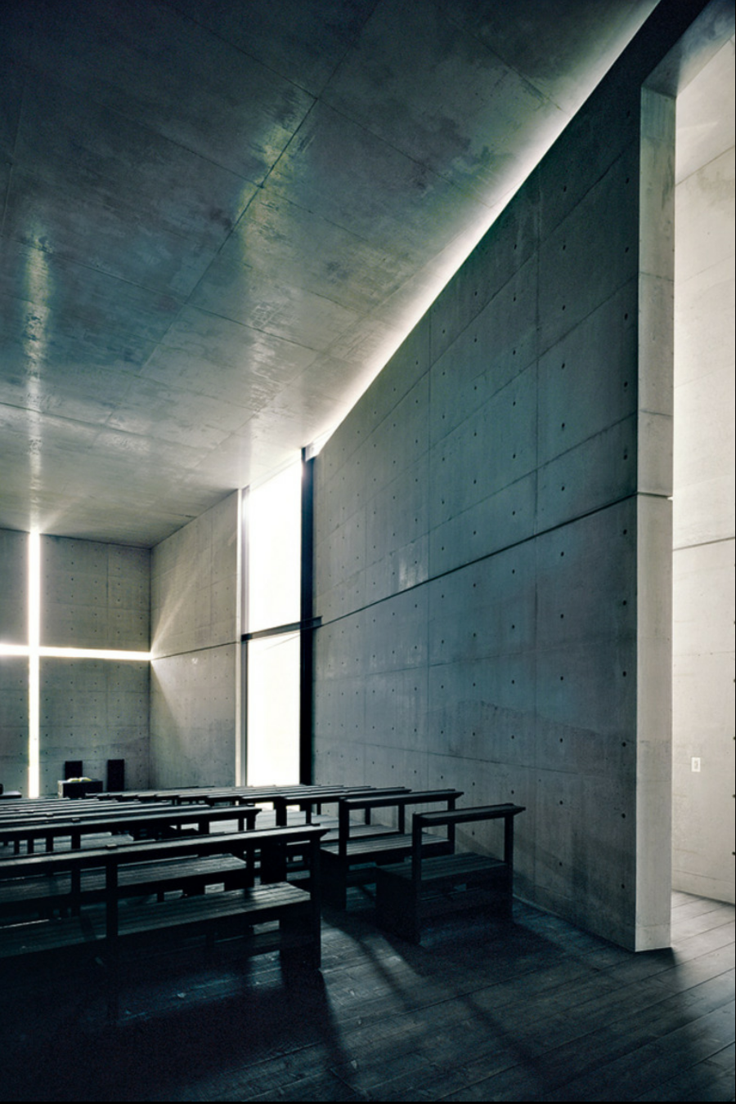
In the church of light, an angled
wall pierces a concrete cube.

Slide 13
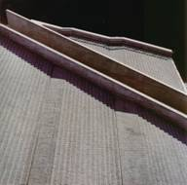
At the Chichu art museum, a wall bisected horizontally encircles the inner courtyard like a medieval rampart.

Slide 14
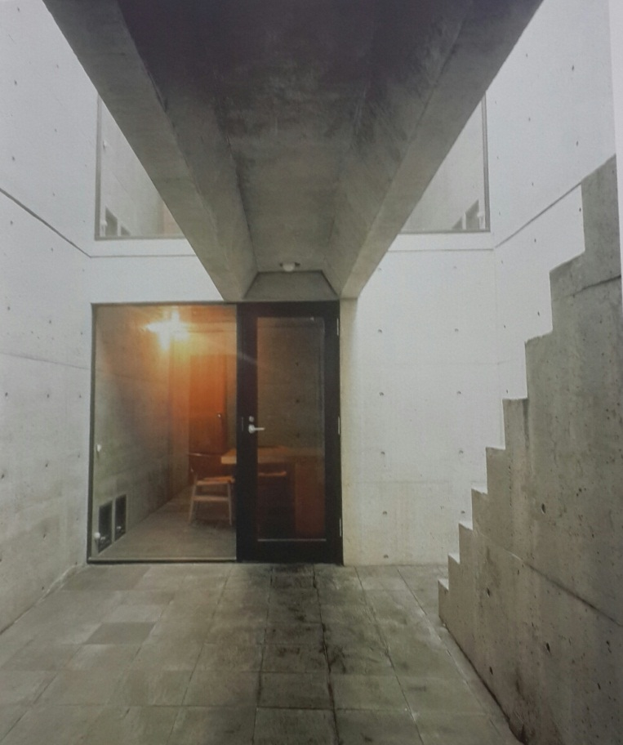
Walls express an inner strength and in them we discover Ando’s convictions.
It validate Ando’s existence and engender his distinct aesthetic of absence.

Slide 15
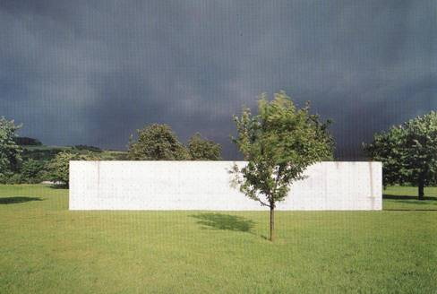
Vitra Seminar House, Weil-am-Rhein (1989-93)
“What I have sought to achieve is a spatiality that stimulates the human spirit, awakens the sensitivity and communicates with the deeper soul.” – Tadao Ando
Notes:
The Box that provokes
“I do not believe architecture should speak too much. It should remain silent and let nature in the guise of sunlight and wind speak”
Creates spaces that respond to human needs and spirit
Juxtaposing powerful concrete walls with light and nature
Deep sense of peace
Simple materials and geometry
Exquisite body of work

Slide 16
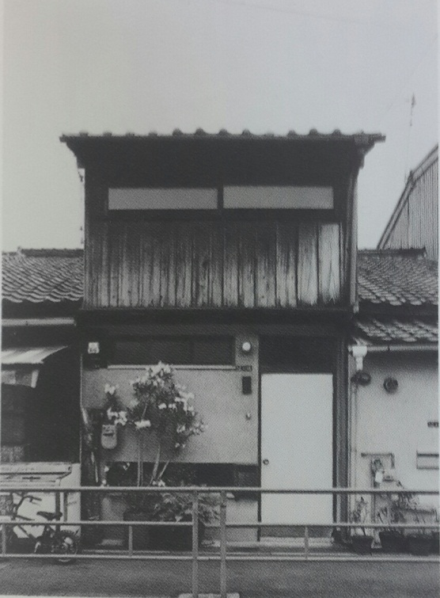
Interpretation
Ando’s grandmother was a very independent woman who wanted her grandson to have the same individuality and learn through physical experience.
Ando’s grandmother’s house

Slide 17
His experiences of life lay the foundation for his views and later become his principle in his profession.
He believes in creating a form with importance to its spatiality rather than creating an interesting form.
According to him it is “shintai” – the soul that experiences each space.
He is deeply moved by the history, Japanese traditions and culture.

Slide 18
Ando believes that architecture is an allegory of its maker.
Ando’s disregard to westernization is reflected in his style of architecture.

Slide 19
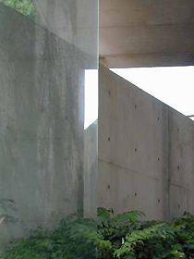
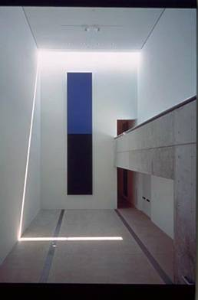
International Library of Children’s Literature Tokyo (2002)
Pulitzer Foundation for the Arts St. Louis (1997-2001)
Notes:
Uses glass and play of light and wind to bring calming nature inside
Timeless and Universal

Slide 20
highly philosophical -uses the traditional Japanese style of architecture which is simple and minimalistic .
interplay of light and dark reveals forms and on the way bring richness back into architectural spaces.

Slide 21
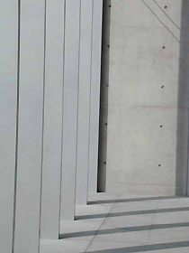
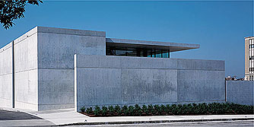
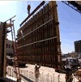
Pulitzer Foundation for the Arts St. Louis (1997-2001)
Notes:
Primary material = Concrete
Precisely crafted wooden forms
Varnished and polished\
Smooth as silk

Slide 22
The boldness that was passed on to young Ando by his grandmother and that he inculcated during his profession as a boxer is also reflected in his perception of his own design.

Slide 23
His first building, Row house, revolves around the concept of family love which he has achieved using an open courtyard that becomes the centre of all interactions.
fallacy - bathroom is separated from the rest of the rooms by this same open courtyard which makes the access difficult during monsoon season.

Slide 24
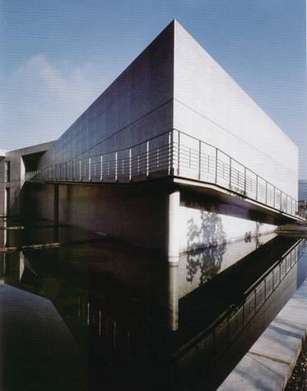
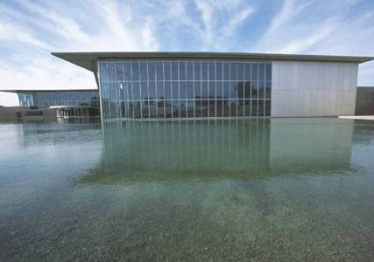
ANDO’S PROJECTS AND BUILDINGS FROM OUR VIEW
Nariwa Museum Nariwa (1992-1994)
The Modern Art Museum Ft. Worth (2002)
Notes:
Water used in other works
Nawira Museum entry ramp
Modern rises from water

Slide 25
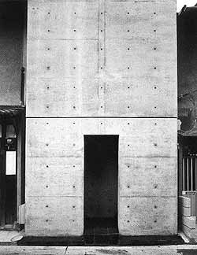
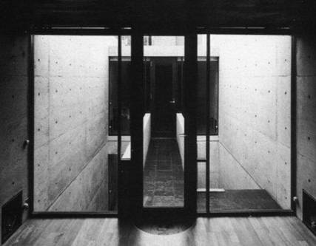
Azuma House Kobe (1975)
Notes:
Opened own firm 1969
Became known with Azuma House
Narrow
Private barrier
Open to nature
Return to traditional Japanese life-style of contact with light, air, rain and other natural elements
Connect building to life that will be lived there

Slide 26
ROW HOUSE
Located in Sumiyoshi", it is a small two-story, cast-in-plane concrete house completed in 1976, is an early work which began to show elements of his characteristic style.
It consists of three equal rectangular volumes: two enclosed volumes of interior spaces separated by an open courtyard.

Slide 27
The courtyard's position between the two interior volumes becomes an integral part of the house's circulation system.
The house is famous for the contrast between appearance and spatial organization which allow people to experience the richness of the space within the geometry

Slide 28
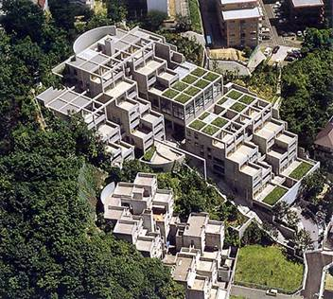
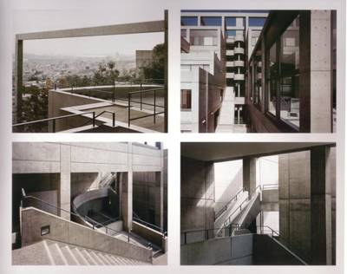
Rokko Housing
Kobe (1981-1983, 1985–1989)
Notes:
1980s
Complex of apartments
Modular cubes 18’
Central stair
Unique apartments

Slide 29
ROKKO HOUSING PROJECT
Ando's housing complex at Rokko, just outside Kobe, is a complex warren of terraces and balconies, atriums and shafts.
The designs for Rokko Housing One (1983) and for Rokko Housing Two (1993) illustrate a range of issues in traditional architectural vocabulary—the interplay of solid and void, the alternatives of open and closed, the contrasts of light and darkness.

Slide 30
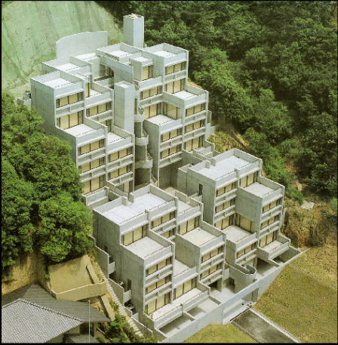
More significantly, Ando's
noteworthy engineering
achievement in these
clustered buildings is site
specific—the structures
survived undamaged after
the Great Hanshin
Earthquake of 1995.

Slide 31
CHURCHES
Ando believes that a place of worship is a place away from all worldly boundaries.
He uses the traditional Japanese style of architecture for the design of a typical westernized catholic church.

Slide 32
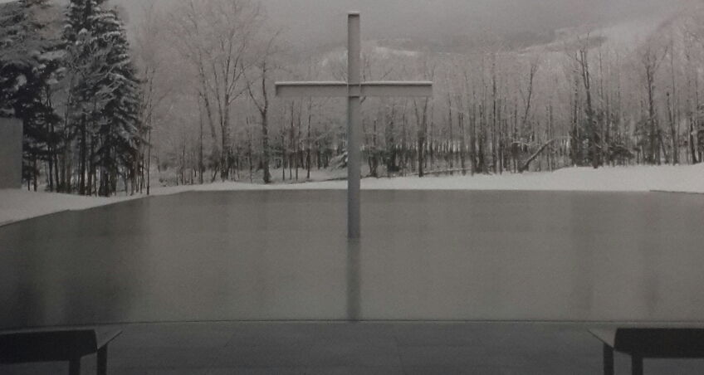
He has designed three churches which revolves around three different elements of nature as the basic concept viz. the church of light, the church of water and the church of wind.
Church on the water

Slide 33
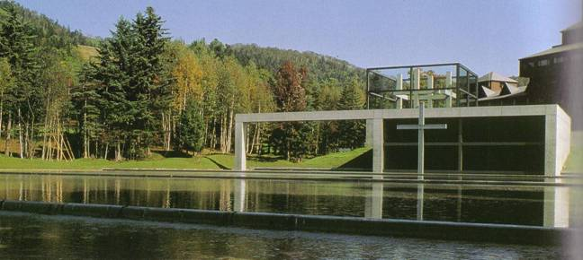
Church on the Water Hokkaido (1985-88)
Notes:
Importance of water
Set in wooded hills

Slide 34
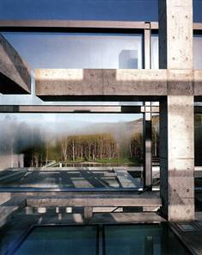
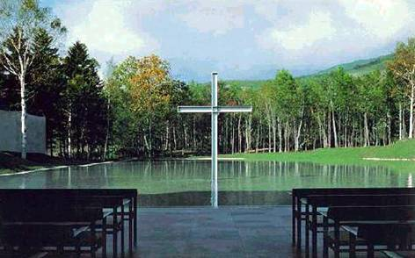
Church on the Water Hokkaido (1985-88)
Notes:
Enter into glass cube room
Descend darkened curved stairway
Open to dramatic vista
Cross in water
Open end to nature

Slide 35
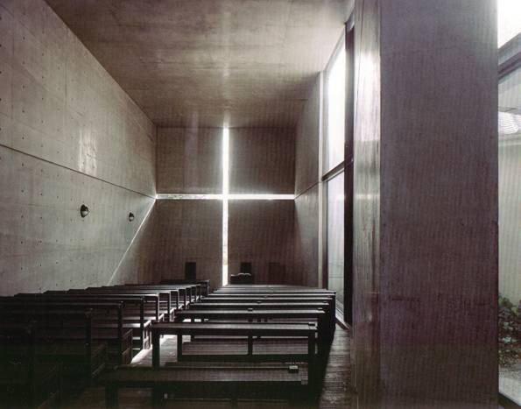
Church of the Light Ibaraki (1987-89)
Notes:
Chapels in 80s and 90s
Light creates a spiritual calm and sense of awe
Approach & turn 180 degrees
Dramatically lit
Cross
Movement

Slide 36
Church of light
It is an astounding example of Ando’s interplay of light and dark.
The church is based on the concept of natural light.

Slide 37
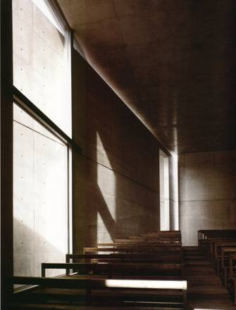
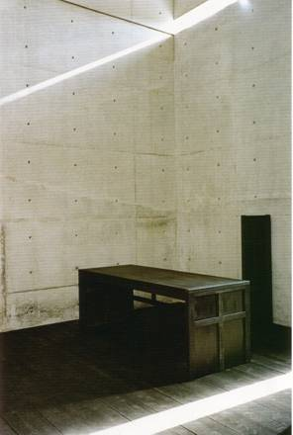
Church of the Light Ibaraki (1987-89)

Slide 38
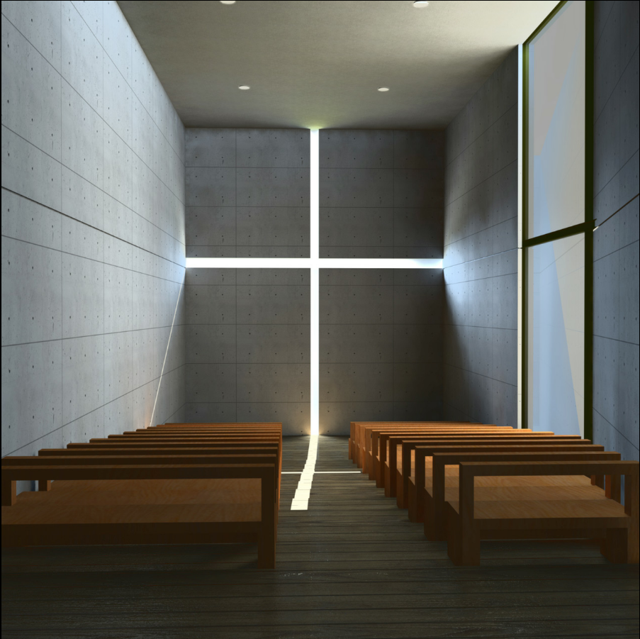
The richness in the design of this church lies in its simplicity.
The huge cross in the
concrete wall through
which light enters
purifies the soul of a true
devotee.

Slide 39
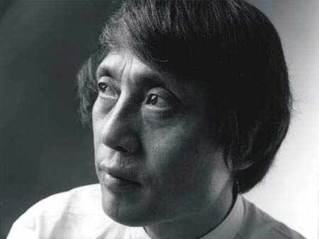
LIFE AND WORK
1941
Born in Osaka , japan,
one of the twin brothers,
he is raised by his
maternal grandmother.
They live by themselves
in a narrow two-storey
house of wooden
construction. His
grandmother is his
most important mentor

Slide 40
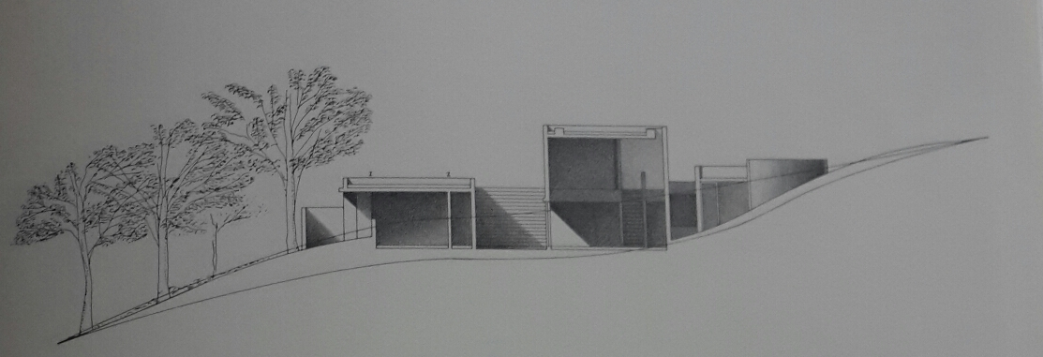
1958
Makes his debut as a professional boxer at the age of 17.
His experience as a professional boxer will have the greatest influence in his life.
50 years later he will still train and exercise every night.

Slide 41
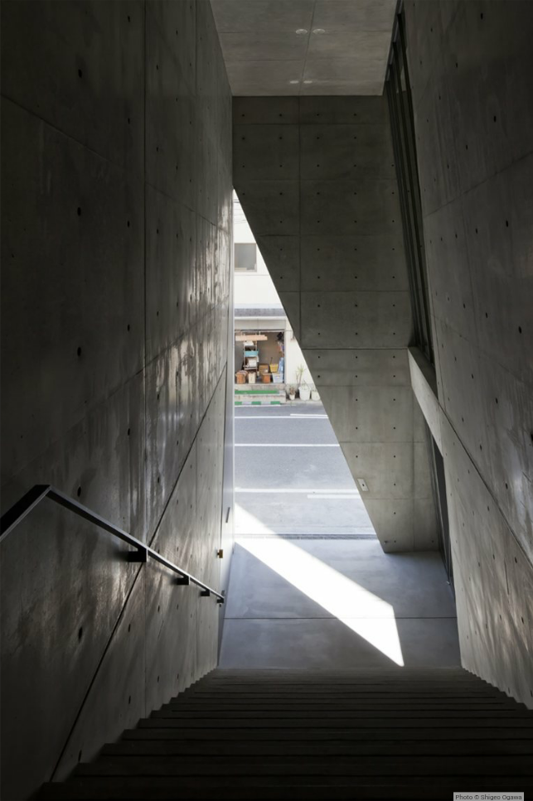
1959
At the age of 18 he is commissioned to design the interior of a nightclub.
1960
Explores traditional temples and tea houses in Kyoto and Osaka in his early20s.
He has decided to educate himself through physical experience rather than schooling.
1965
Travels around the world to educate himself in architecture at 24

Slide 42
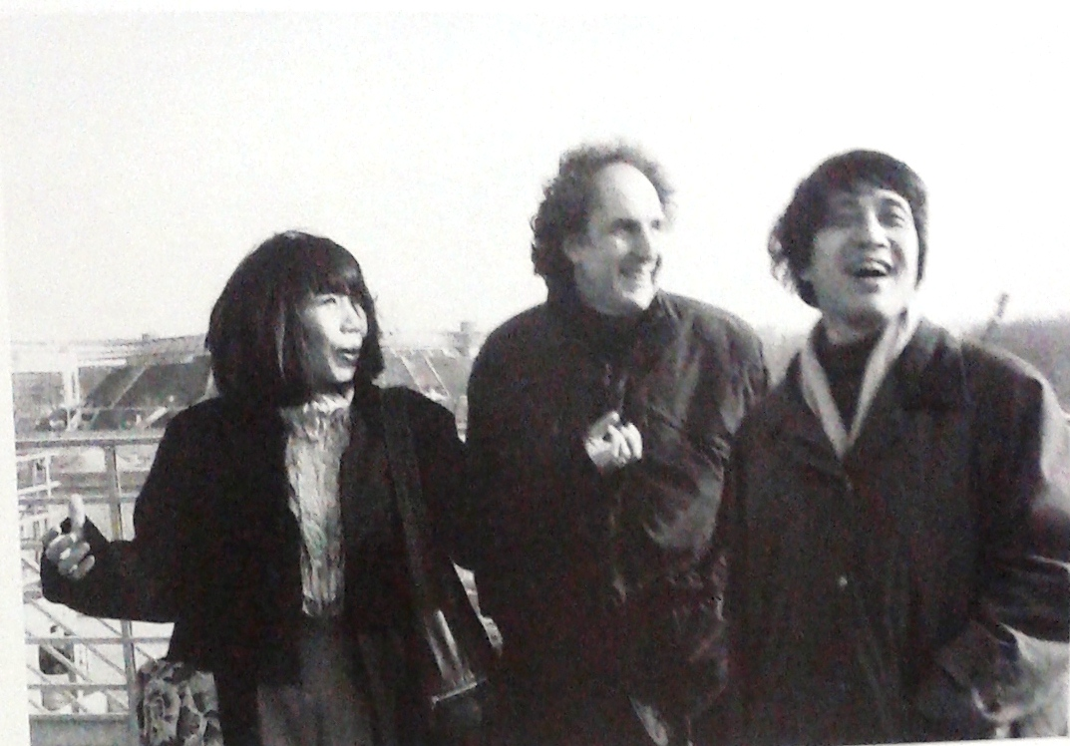
1969
Establishes his own office in Osaka after travelling all over the world for four years.
His office becomes an exciting salon for young architects.
He marries Yumiko Kato then an assistant in his office.

Slide 43
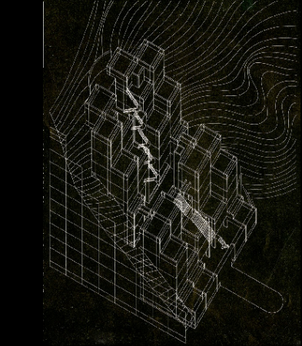
1973
Designs the Tomishima house in Osaka for his friend
1979
Awarded the annual prize
from the architectural
institute of Japan.
1980
Completes the Kostumo
house.
1983
Completes the Rokko
housing 1 in Kobe

Slide 44
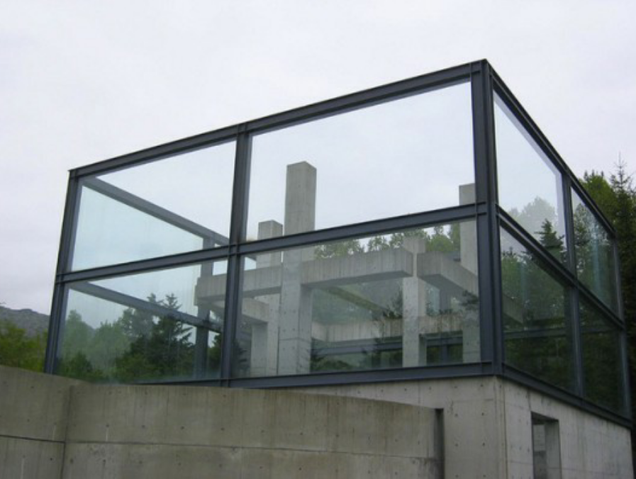
1985
Awarded the 5th Alvar
Aalto medal by the Finnish
association of architects
1986
Completes chapel in
mount Rokko in Kobe,
sometimes called the chapel of the winds.

Slide 45
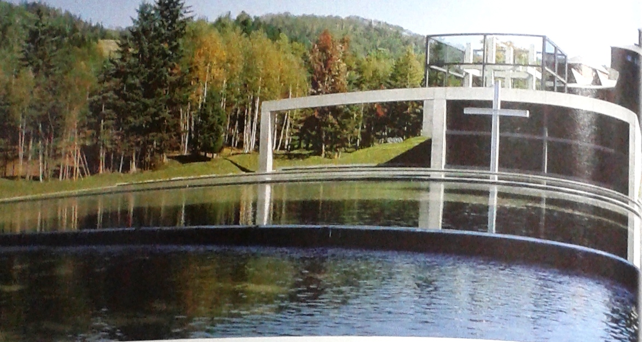
1987-1990
Serves as visiting professor in Yale, Columbia and Harvard universities.
1988
Completes Church on the water in in Hokkaido.
1989
Awarded the Gold medal of architecture by the French academy of Architecture. He completes the Church of light in Osaka.

Slide 46
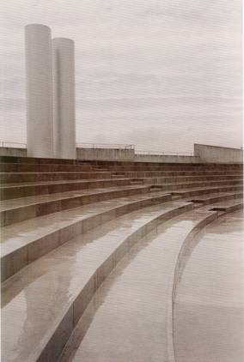
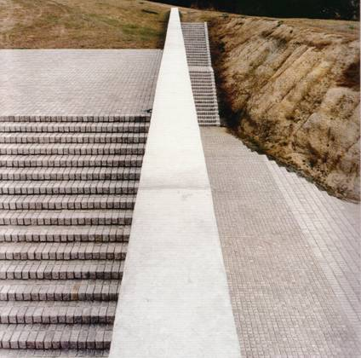
Naoshima Contemporary Art Museum Kagawa (1988-92)
Children’s Museum Himeji (1987-89)
Notes:
Water also creates paths
Paths an important theme
Children’s Museum = waterfall terraces
Naoshima = wide stairway and diagonals lead to top
1995 Pritzker Prize

Slide 47
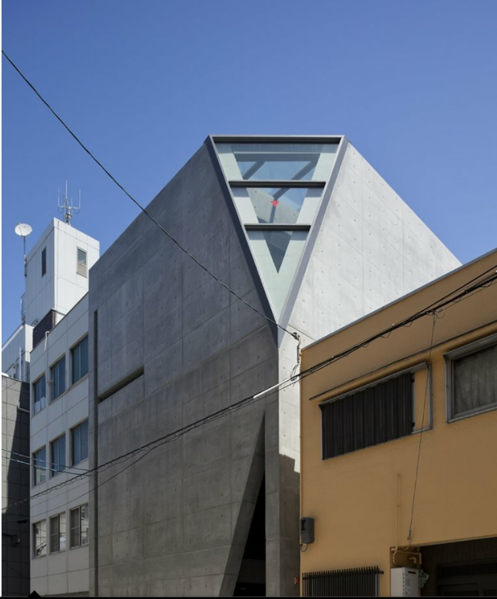
1992
Completes the Japan pavilion for Expo 92 in Seville.
1995
Awarded the Pritzker architecture prize, USA.

Slide 48

1997
Awarded the Royal Gold Medal of the Royal Institute Of British Architects, UK. He is
appointed professor at the University of Tokyo.
1999
Completes Rokko housing 3 in Kobe.
2001
Completes the Pulitzker foundation for arts in St. Louis, USA

Slide 49

2005
Awarded the Gold medal of
Union Internationale des
Architectes, Paris.

Slide 50

THE END

